Slide 1

GLOBAL SUPERSTORE SURVEY
BY-
NEHA SURANA (EBEON1022673326)6
BHASKAR JAIN (EBEON1022665043)

Slide 2



INTRODUCTION
LOADING OF DATA
UNDERSTANDING OF DATA
CLEANING OF DATA
ANALYSING THE DATASET OF GLOBAL SUPERSTORE USING POWER BI
STUDY AND ANALYSIS OF DASHBOARD
ANALYSING THE DATASET OF GLOBAL SUPERSTORE USING PYTHON
DRAWING MEANINGFUL INSIGHTS

Slide 3
There are total 24 columns and 51291 rows in dataset. Furniture, Office Supplies and Technology are the categories for sale.
Perform ETL i.e. Extract Transform and Load.
Sort and Clean the data.
Data Modelling is done to relate the data elements
From the data modelling, It can be identified where the sales are lacking, shipping cost per sales, which is the top category and what are the target sales etc.

Slide 4
POWER BI
Funnel Chart |Clustered Bar Chart |PI Chart |Ribbon Chart |Tree Map |Cards| Waterfall Chart | KPI | Filled Map | Slicer

Slide 5
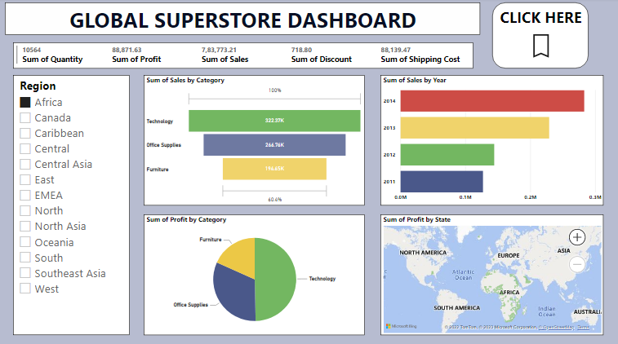
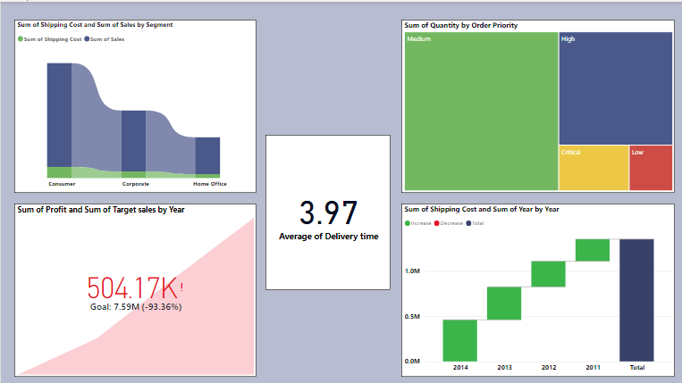
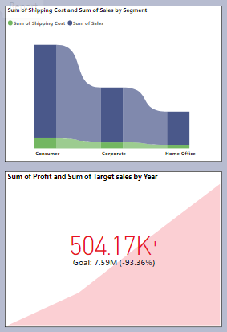
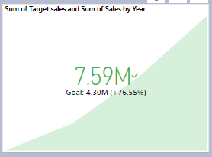
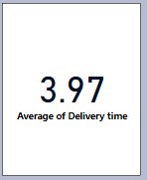

Slide 6
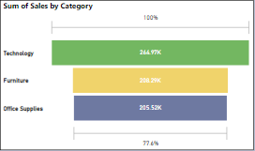
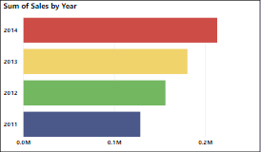
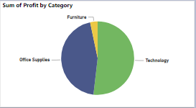
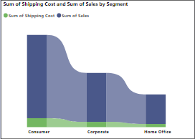
FUNNEL CHART
A funnel chart represents the sale of different categories. Here it can be identified in which category the sale is lacking.
STACKED COLUMN CHART
Stacked column chart shows the step by step increasing of sales by year.
PIE CHART
Pie chart gives the details of the category wise profit .
RIBBON CHART
Ribbon chart is used to represent the sum of sales and shipping cost for the category wise products.

Slide 7
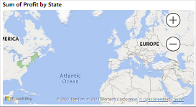
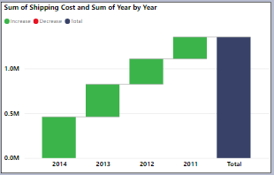
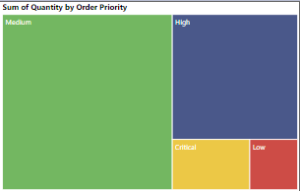
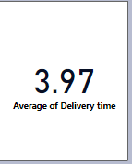
FILLED MAP
This filled map represents the profit according to the state.
Card represents the average delivery time taken.
Tree map represents the sum of quantity by order priority.
TREE MAP
Waterfall chart represents the sum of shipping cost by year and total sum of shipping cost.
WATERFALL CHART
CARD

Slide 8

PYTHON PROGRAMMING
USING JUYPTER NOTEBOOK| LOAD DATASET| ANALYSIS| VISUALIZATION

Slide 9
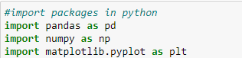
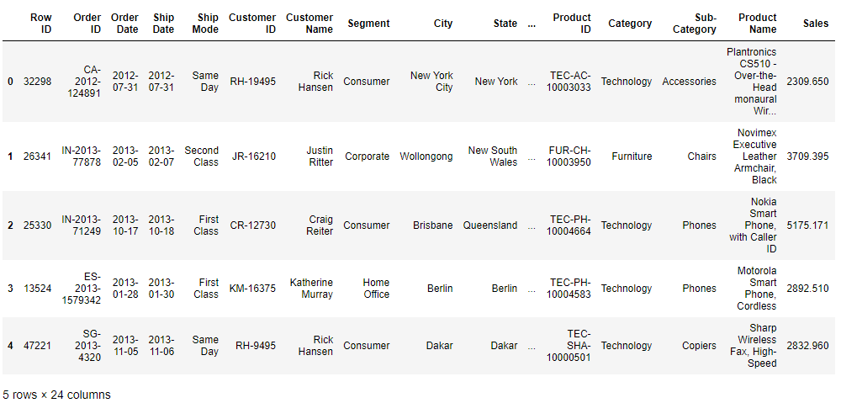

LOADING DATASET
IMPORTING OF PACKAGES

Slide 10

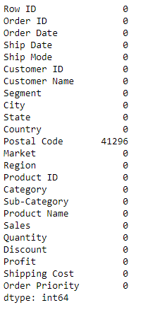
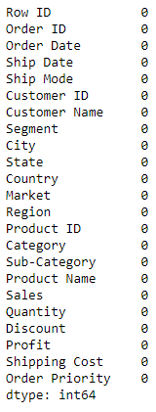

DATA CLEANING

Slide 11
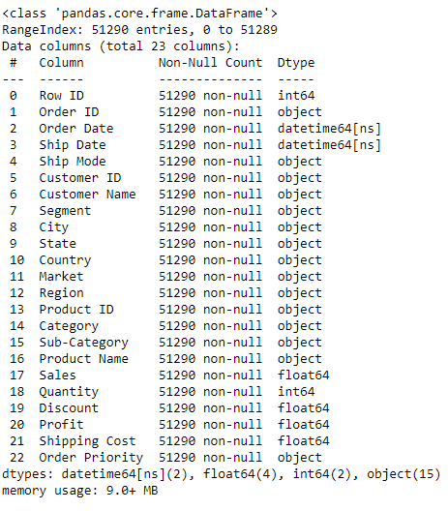

DETAILED INFORMATION OF DATASET

Slide 12
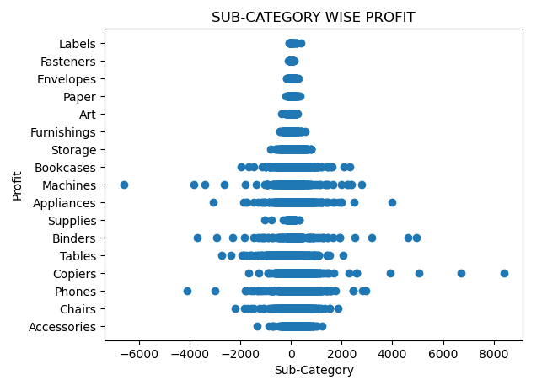
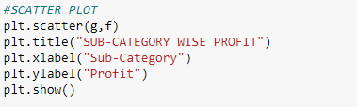
VISUALIZATION
SCATTER PLOT
Scatter plots are the graphs that present the relationship between two variables in a data-set.

Slide 13
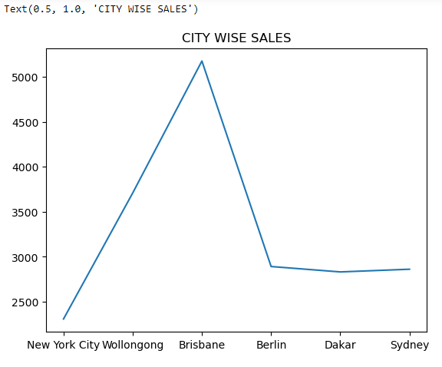
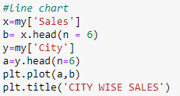
LINE GRAPH
A line graph displays quantitative values over a specified time interval.

Slide 14
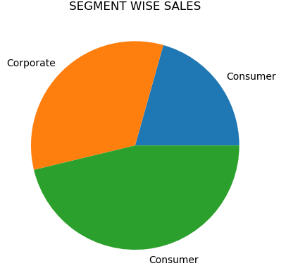

PIE CHART
A pie chart is a way of summarizing a set of nominal data or displaying the different values of a given variable

Slide 15

MICROSOFT EXCEL
LOAD DATASET| ANALYSIS| VISUALIZATION| KPI

Slide 16
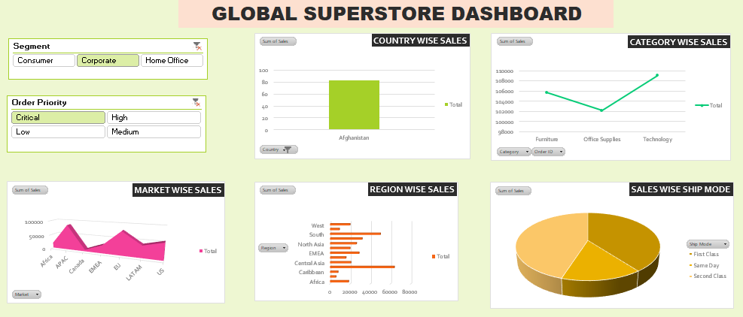

Slide 17
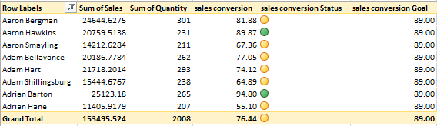
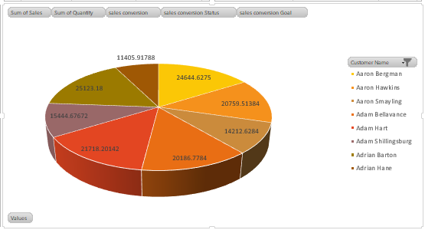
KPI
KPI stands for key performance indicator, a quantifiable measure of performance over time for a specific objective. KPIs provide targets for teams to shoot for, milestones to gauge progress, and insights that help people across the organization make better decisions.
Here KPI is used to calculate the sales conversion and analyze the performance to achieve the targets.
DIVIDE(SUM(Orders[Sales]),SUM(Orders[Quantity]),BLANK())

Slide 18
THANK YOU

